Slide 1
Git Branches

Slide 2
Objectives
Branches
Merges
Conflicts

Slide 3
Recap- Git Workflow
1

Slide 4
Recap-What is Git?
Git is an open source distributed version control system
Tracks and records changes to files over time (versioning)
Can retrieve previous version of files at any time (time travel)
Can be used locally, or collaboratively with others (teamwork)
Contains extra information such as date, author, and a message explaining the change
Compare and Blame
What changed
When it changed
Why it changed
Who changed it

Slide 5
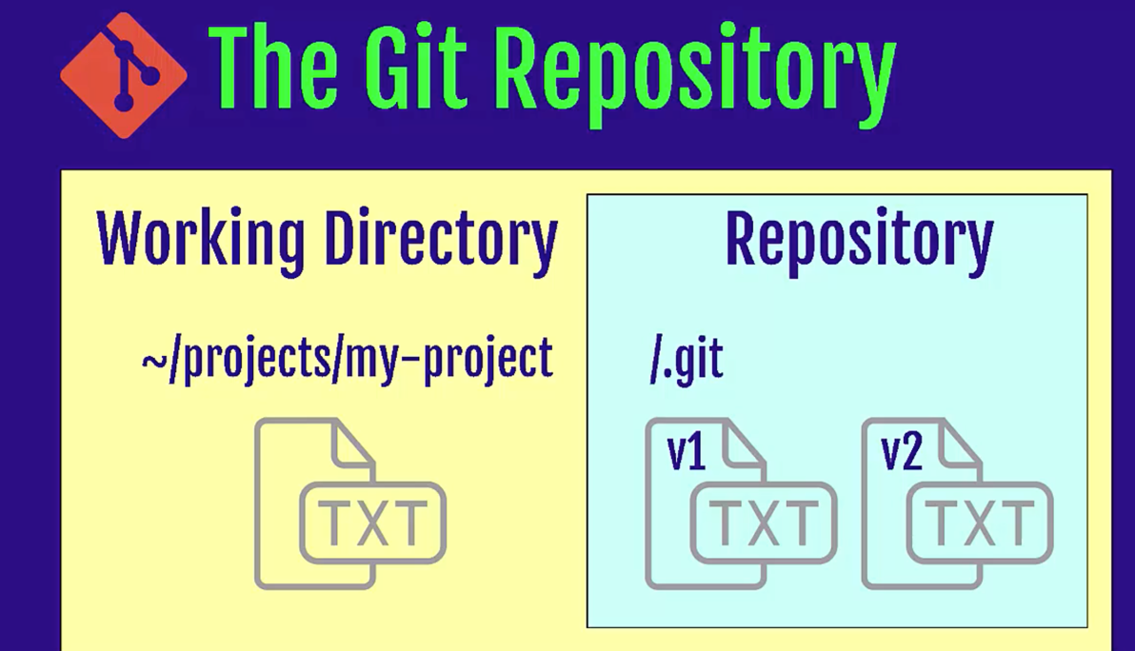
Recap-Git Repository
What is a repository
A directory or storage space where your projects can live.
Local Repository
Remote Repository (Central Repository)
Notes:
Let’s start getting our hands dirty.
Step by step.
Try to do whatever I do.
What is CLI?
Why do we use CLI over GUI?
Some CLI commands. You’ll see more commands tomorrow. It’s a demo only.
Repository is not only your files but also all the information about the changes made on your project files.
Repo can live in your computer or remotely on hosted server (cloud)
Let’s see what it looks like?
Git doesn’t care about working directory a lot.
Because it can be changed immediately.
Desktop create a folder named projects
capital-one-project
check git is installed correctly
git config --global user.name “Name”
git config --global user.email
git init

Slide 6
Recap-Git Config
Git needs your identity to mark/label changes / editor
git config --global user.name “Your Name” t
git config --global user.email “Your Name” t
git config --global core.editor “vim” t
git config --list t
Notes:
For different repositories if you like to define different username or email use the command without global option.
git config user.name

Slide 7


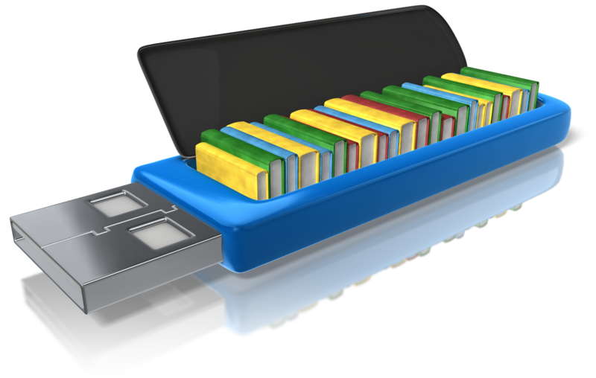
Recap-Workflow-Git’s “three trees”
Working Directory Staging Area (Index) Repository (Commit Tree)
Where you work.Create new files, edit files delete files etc.
Before taking a snapshot, you’re taking the files to a stage. Ready files to be committed.
Committed snapshots of your project will be stored here with a full version history.

Slide 8
Recap-Basic Commands
git help
git init
git status
git add .
git rm --cached
git commit -m “abc”
git log
git checkout commitID
Local Machine
GitHub
Working directory
Staging area (index)
Git repository
Remote Git repository
git add
git commit
git checkout

Slide 9

Recap-Tasks
Create a new repo under my-second-project folder
Create a file named file1.txt
Change the file
Stage the file
Commit the file to your repo
Task-1
Create a file named file2.txt
Edit file2.txt
Stage
Delete the file file1.txt
Rename file2.txt >> file3.txt
Stage file3.txt
Unstage file3.txt
Stage file3.txt again
Commit the file to your repo
Change the message of the commit
Switch back to your first commit in Task-1
Task-2
Notes:
🍐 This is a Pear Deck Text Slide
🍐 To edit the type of question, go back to the "Ask Students a Question" in the Pear Deck sidebar.

Slide 10
Recap-Solutions
Create a new repo under my-second-project folder git init t
Create a file named file1.txt touch file1.txt t
Change the file vim file1.txt t
Stage the file git add . t
Commit the file to your repo git commit -m “message”t
Create a file named file2.txt touch file2.txt t
Edit file2.txt vim file2.txt t
Stage git add . t
Delete the file file1.txt rm file1.txt t
Rename file2.txt >> file3.txt mv file2.txt file3.txt t

Slide 11
Recap-Solutions Cntd.
Stage file3.txt git add . t
Unstage file3.txt git rm --cached file3.txt t
Stage file3.txt again git add . t
Commit the file to your repo git commit -m “message” t
Change the message of the commit git commit --amend t
Switch back to your first commit in Task-1 git log t
git checkout “first commit ID” t

Slide 12
Git
Branch, Head
What comes to you your mind when you hear this?
Notes:
🍐 This is a Pear Deck Text Slide
🍐 To edit the type of question, go back to the "Ask Students a Question" in the Pear Deck sidebar.
Today no coding,
Pre-class, what did you learn about Git?
In IT, there’s a tenancy to use more complicated words. Big Words.
It’s just vocabulary. We’ll see a lot of those words today.
I’ll make things simpler.

Slide 13
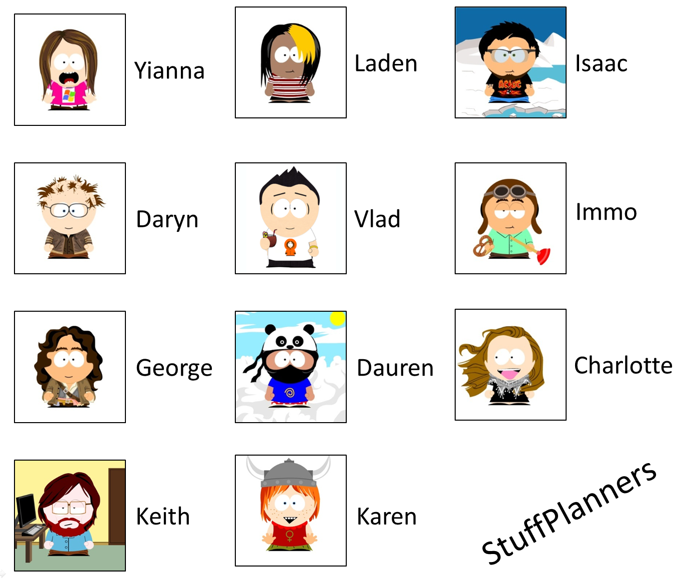
Git Branches
History Tracking
Spelling correction
Feature description
Create document
Company logo
Grammar fix
Color change
T i m e a n d V e r s i o n s
Notes:
If we drew a picture of the activities of you working on one of those files that we just described, you might for each of the points in time describe what you did to the file, why you changed it, and then you'd like the tool itself to record. what the contents of that change were, from one word to another.
a spelling correction, the change of a color or a background, or adding a company logo to the top of a webpage or even a Word document.
For a single individual, this doesn't seem too hard, and for a single file, it seems relatively straightforward.
Many individual products are putting this into the product themselves, this idea of keeping a history.

Slide 14

Git Branches
Collaborative History Tracking
Spelling correction
Feature description
Create documnet
Company logo
Grammar fix
Color change
T i m e a n d V e r s i o n s
Notes:
For a single individual, I repeat, this is again rather straightforward and rather simple. But where Git really shines is when we start talking about this in the collaborative sense:
you and other team members trying to do the same thing. even worse: on the same files.
When you do that, you need something much more capable than a simple revision history of
a single file for a single person. You need the idea of keeping track of who changed it, when they changed it, why they changed it.
but the capability of the tool to unify these back together in what is typically referred to as a merge.
These actions, these interleavings of you and the team members working on the same, similar, or adjacent files is handled adeptly by a full-fledged version control system like that of Git.

Slide 15
Git Branches
Git Branches
Collaborative History Tracking
T i m e a n d V e r s i o n s

Slide 16
Git Branches
Collaboration
Task 1
+
Task 2
+
Task 2
Combined Tasks

Slide 17

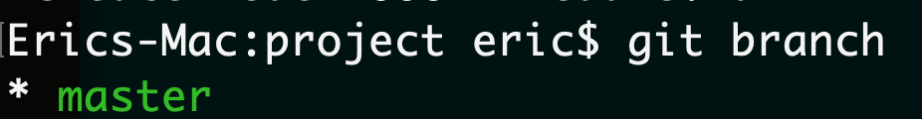

Branches
Production of the project lives on master/main branch
Branches are reference to a commit
Notes:
Here's an example of how Git branches are useful. Let's say you need to work on a new feature for a website. You create a new branch and start working. You haven't finished your new feature, but you get a request to make a rush change that needs to go live on the site today. You switch back to the master branch, make the change, and push it live. Then you can switch back to your new feature branch and finish your work. When you're done, you merge the new feature branch into the master branch, and both the new feature and rush change are kept!
Why do we use branches? Only the final work should be on master branch. All the work we do should be on seperate branches until it’s ready.

Slide 18
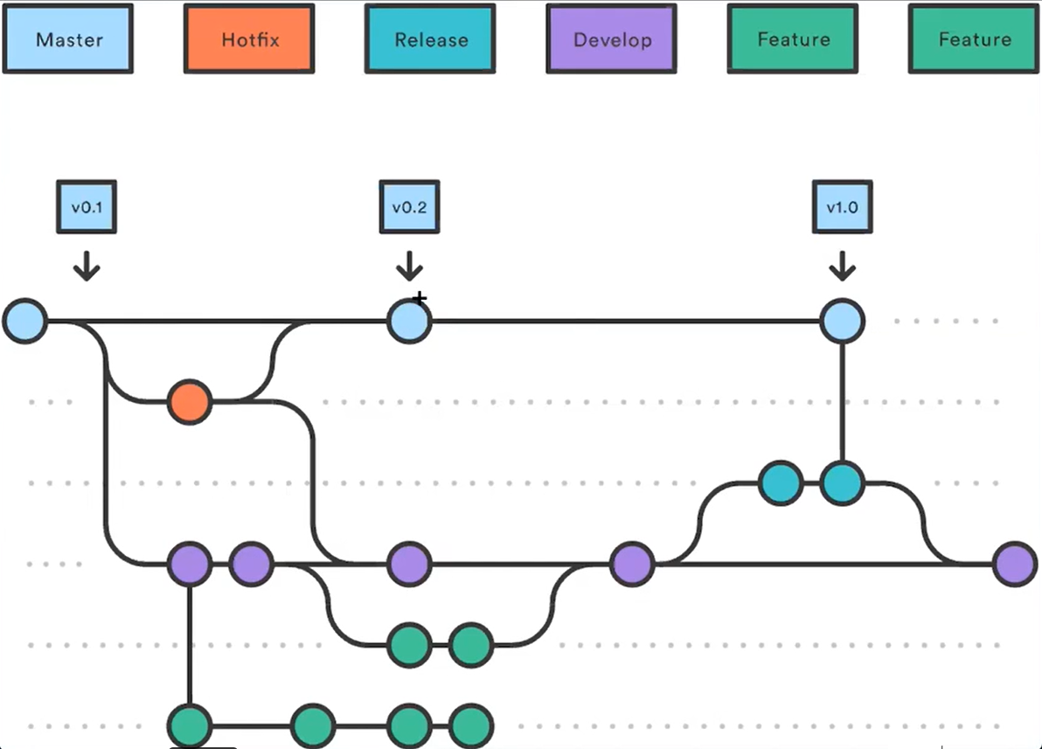
Branches
Notes:
Here's an example of how Git branches are useful. Let's say you need to work on a new feature for a website. You create a new branch and start working. You haven't finished your new feature, but you get a request to make a rush change that needs to go live on the site today. You switch back to the master branch, make the change, and push it live. Then you can switch back to your new feature branch and finish your work. When you're done, you merge the new feature branch into the master branch, and both the new feature and rush change are kept!
Why do we use branches? Only the final work should be on master branch. All the work we do should be on seperate branches until it’s ready.

Slide 19
Branches
to see local branches
git branch t
to see remote branches
git branch -r t
to see all branches
git branch -a t

Slide 20
Creating/switching branches
create a new branch
git branch Branch name t
switch to a branch
git checkout Branch name t
create a new branch and switch to that branch
git checkout -b Branch name t
Notes:
http://git-school.github.io/visualizing-git/
Let’s practice visually.
Scenario 1:
I have master branch and creating a new branch and do some experiment on it. but i didn’t like it and i want to go back to master. And delete eric branch since I wont use it what happens? when i do new commit where it goes?
git commit
git commit
git checkout -b eric
git commit
git commit
git commit
git checkout master
git branch -d eric
git commit
Scenario 2:
We created a new branch and we liked the changes. we want to merge
git commit
git commit
git checkout -b eric
git commit
git commit
git commit
git checkout master
git merge eric
You have performed a fast-forward merge.

Slide 21
Deleting branches
delete a local branch
git branch -d Branch name t
git branch -D Branch name t
Notes:
The -d option only deletes the branch if it has already been merged. The -D option is a shortcut for --delete --force, which deletes the branch irrespective of its merged status.
Visualizing Git- Show branches
Scenario1: go back to a commit and create a new branch from there.
git checkout 551c4bd
git checkout -b raymon
git commit
git commit
git commit
git commit
git checkout master
git commit
git commit
git merge raymon
git checkout eric
git branch -d raymon
git checkout master
git commit
Scenario2: delete the branch before merging with -d (Do it on your computer not visually)
it will give you an error.
Once you’re done with the feature you can merge back into master

Slide 22
Fast forward merge
Fast forward merge is possible when there are no further commits in the receiving branch after the commit where feature branch was created
HEAD
master
Root
commit
feature-1
Time

Slide 23
Fast forward merge
git merge <feature-branch>
HEAD
Root
commit
master
feature-1
Time

Slide 24
3-way merge
HEAD
master
Root
commit
Ancestor
feature-1
Time

Slide 25
3-way merge
HEAD
master
Merge commit
Root
commit
Ancestor
feature-1
Time

Slide 26
Merge Conflicts
Same files were edited in both branches
HEAD
master
Root
commit
Ancestor
feature-1
Time

Slide 27
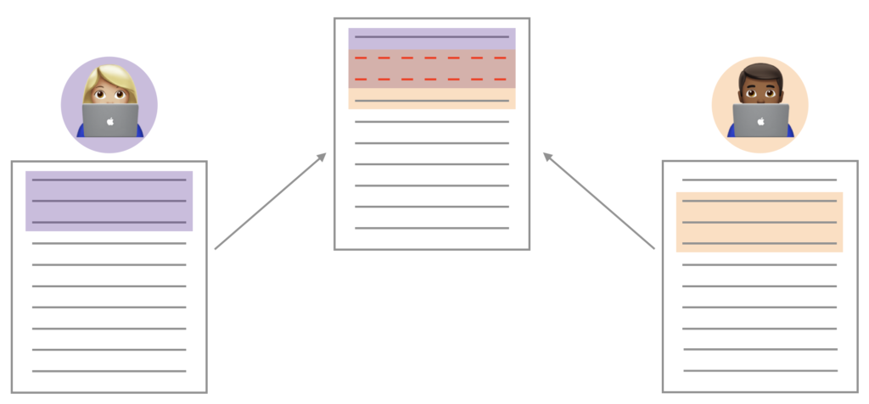
Github - Merge Conflict
Merge conflicts happen when you merge branches that have competing commits, and Git needs your help to decide which changes to incorporate in the final merge.
Notes:
Pull Request ile ilgili senaryo.
Live representation.
remote origin/upstream -
Merge, rebase, conflicts
Cherry pick

Slide 28
THANKS!
Any questions?

